Slide 1
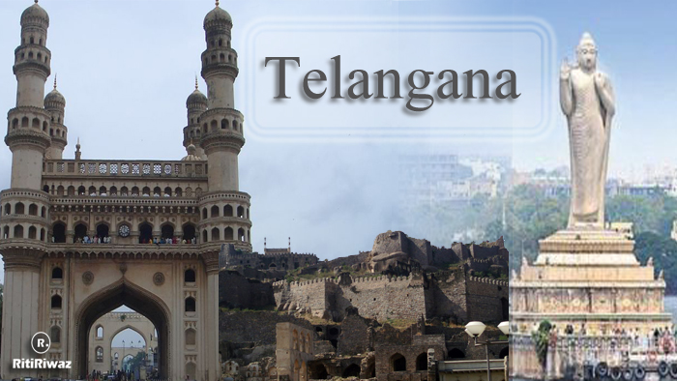


TELANGANA GROWTH ANALYSIS
PREPARED BY
DHARMANA LEELAMBARA DATTA

Slide 2

AGENDA
01
02
03
04
About Telangana State
Goals and objectives
Stages involved in the project
Primary Research
05
06
07
08
Secondary Research
Insights
Recommendations
Conclusion

Slide 3



ABOUT TELANGANA STATE
Telangana, located in southern India with Hyderabad as its capital, is known for its rich culture and remarkable economic growth. It follows a fiscal year from April to March and has implemented initiatives like TS-I PASS, streamlining industrial approvals and boosting investments and employment.
The state's economic landscape is diverse, driven by stamp registration, transportation, and industrial sectors, all contributing significantly to its revenue. Different districts display varying growth patterns, with some holding substantial potential for expansion. Government policies play a pivotal role in shaping the state's trajectory, with data-driven analyses aiding in policy evaluation.
Telangana's progressive governance has made it an attractive destination for businesses and investors, propelled by the effective use of data-driven insights in policy-making. This synergy positions Telangana on a path of sustained economic growth and prosperity.

Slide 4

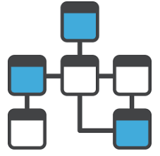
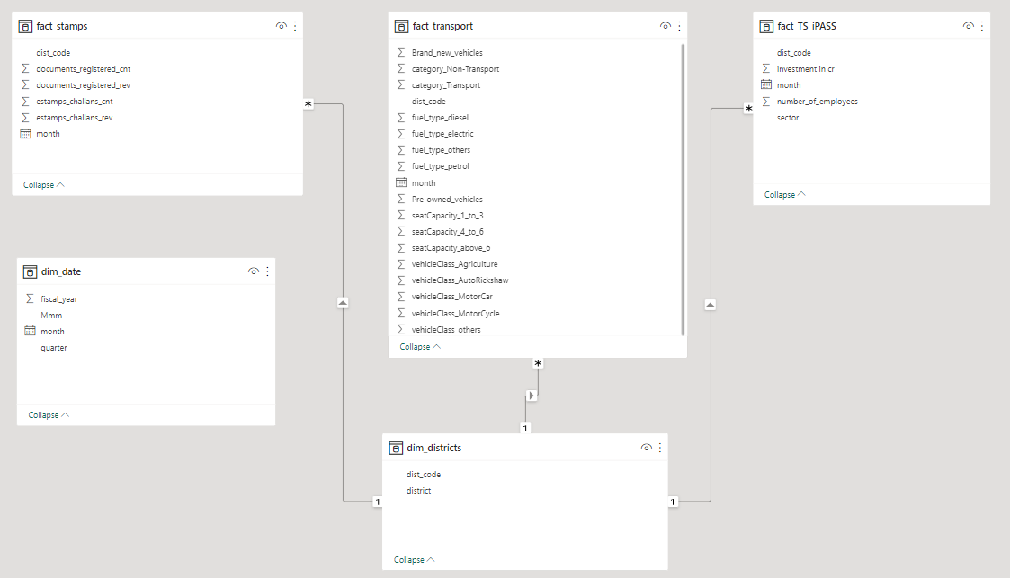


SCHEMATIC VIEW OF DATA MODEL
This Photo by Unknown Author is licensed under CC BY

Slide 5

GOALS AND OBJECTIVES
GOALS
This project's central aim is a comprehensive analysis of Telangana's growth trajectory via five key datasets: dim_districts, dim_date, fact_stamps, fact_transport, and fact_TS_iPASS. The objectives encompass understanding data attributes, identifying trends, uncovering growth opportunities, establishing correlations, and visualizing insights. Ultimately, the project seeks to empower stakeholders with actionable data-driven insights, facilitating informed decision-making for sustained growth and prosperity in Telangana.
OBJECTIVES
• Explore Stamp Registration, Transportation and Ts-Ipass Datasets. Understand their attributes, categories and time period.
• Analyze trends and patterns within each department.
• Identify growth opportunities and areas needing attention.
• Find correlation among these departments and report the overall growth of the state through insights and relevant visuals such as shape maps.

Slide 6

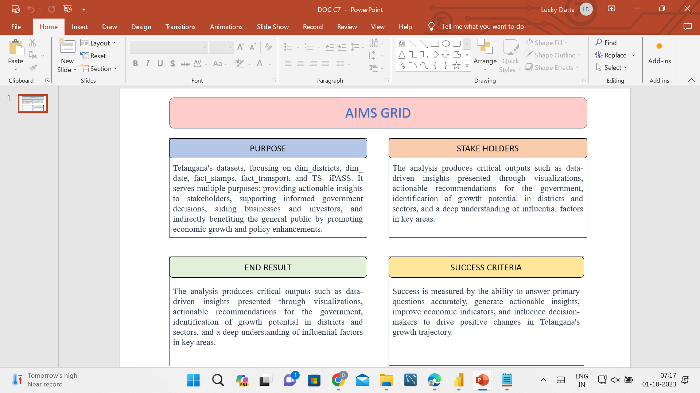
AIMS GRID

Slide 7
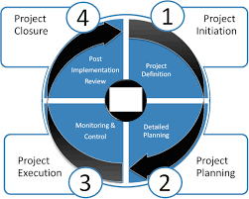
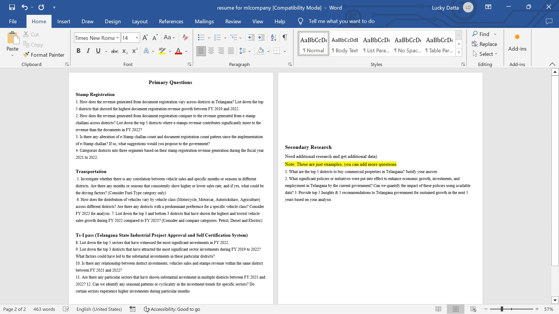

STAGES IN THE PROJECT

Slide 8
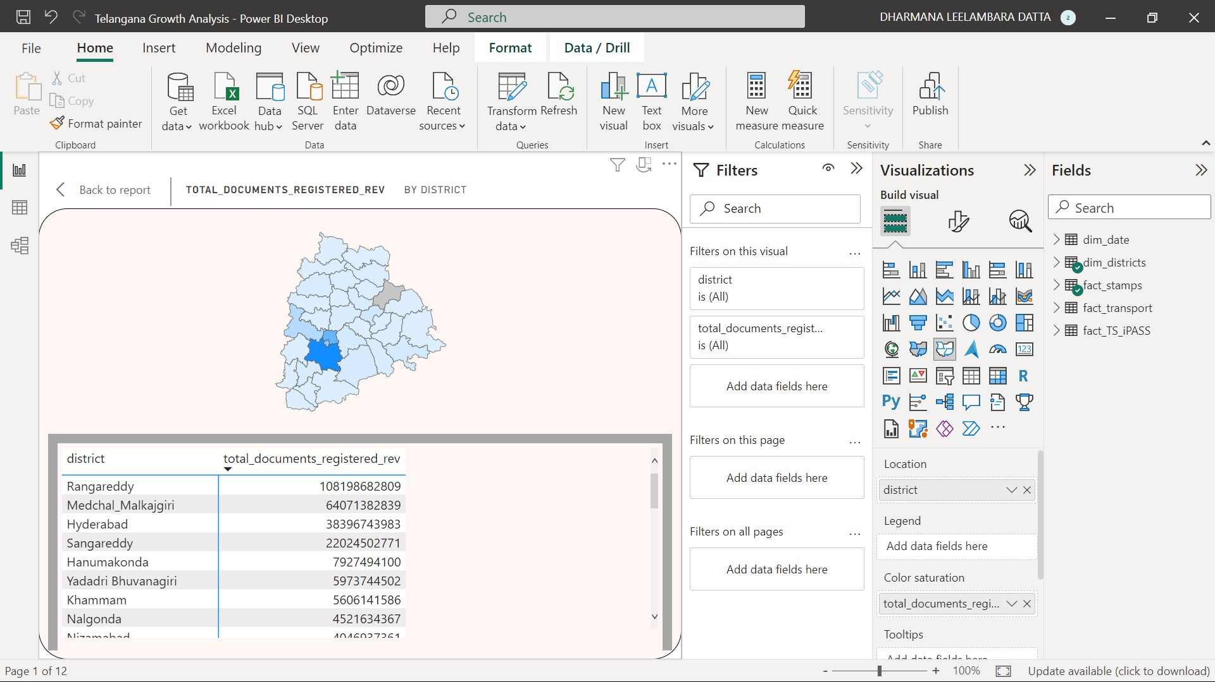
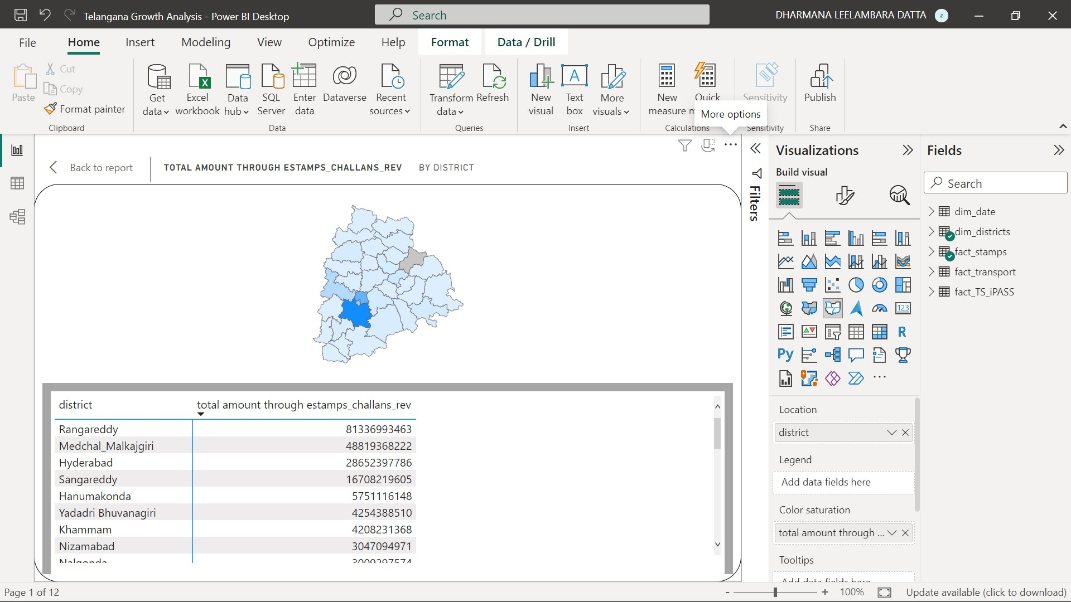
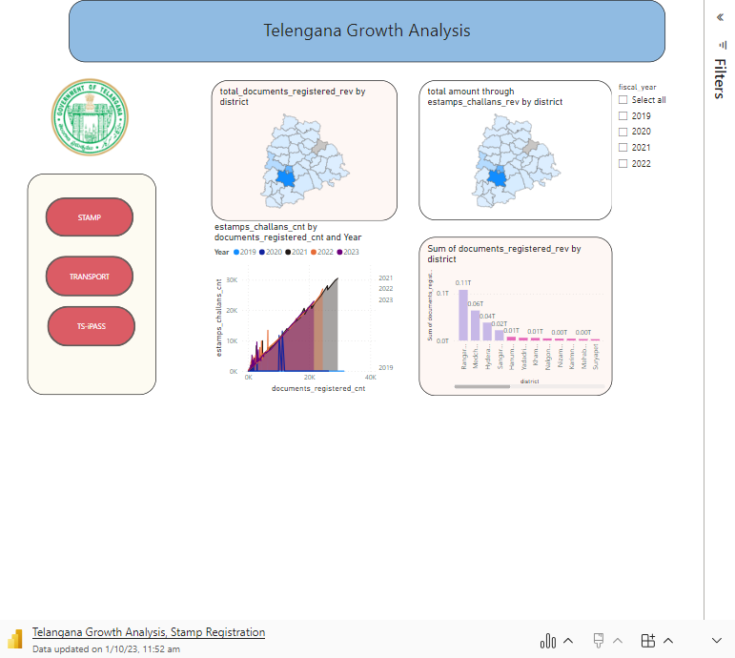
PRIMARY RESEARCH
STAMP REGISTRATION
How does the revenue generated from document registration vary across districts in Telangana? List down the top 5 districts that showed the highest document registration revenue growth between FY 2019 and 2022.
How does the revenue generated from document registration compare to the revenue generated from e-stamp challans across districts? List down the top 5 districts where e-stamps revenue contributes significantly more to the revenue than the documents in FY 2022?

Slide 9
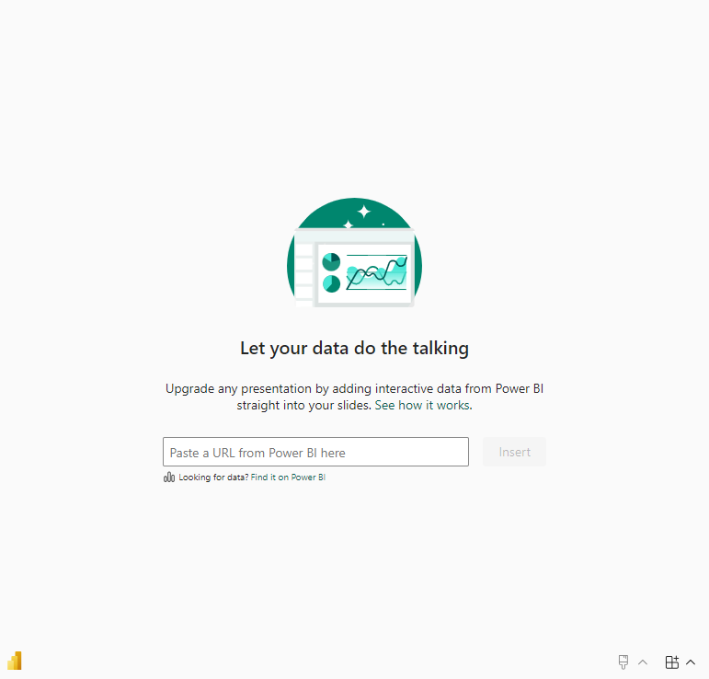
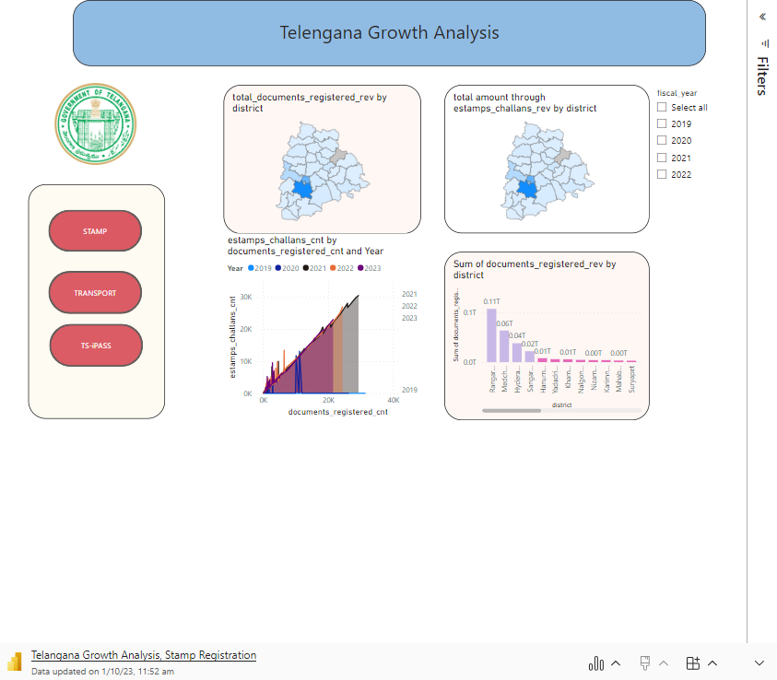
PRIMARY RESEARCH
Is there any alteration of e-Stamp challan count and document registration count pattern since the implementation of e-Stamp challan? If so, what suggestions would you propose to the government?.
Incomplete Reporting ,System Issues ,Manual Errors ,Duplicate Entries and Process Bottlenecks
So, the overall percentage of people who have not e-challan count across the three scenarios is approximately 6.03%.
Enhance communication between different departments involved in the registration and tracking process to address any discrepancies promptly.
Implement a robust data management system that tracks documents from registration to completion, providing real-time updates.
Regularly monitor and reconcile registered documents with e-challana records to identify inconsistencies early.
Conduct periodic audits and quality checks to ensure data accuracy and compliance with established procedures.
Categorize districts into three segments based on their stamp registration revenue generation during the fiscal year 2021 to 2022.

Slide 10

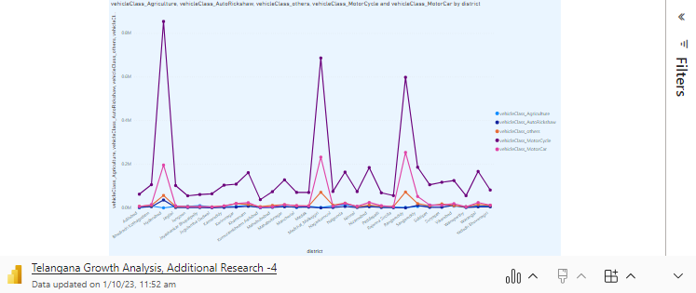
PRIMARY RESEARCH
TRANSPORTATION
Investigate whether there is any correlation between vehicle sales and specific months or seasons in different districts. Are there any months or seasons that consistently show higher or lower sales rate, and if yes, what could be the driving factors? (Consider Fuel-Type category only)
How does the distribution of vehicles vary by vehicle class (Motor Cycle, Motor Car, Auto Rickshaw, Agriculture) across different districts? Are there any districts with a predominant preference for a specific vehicle class? Consider FY 2022 for analysis.

Slide 11
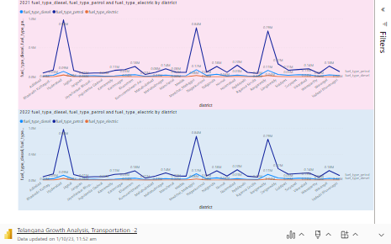
PRIMARY RESEARCH
TRANSPORTATION
List down the top 3 and bottom 3 districts that have shown the highest and lowest vehicle sales growth during FY 2022 compared to FY 2021? (Consider and compare categories: Petrol, Diesel and Electric)
Top 3 districts are
Adilabad
Bhadadri kothagudem
Hyderabad
Bottom 3 districts
Wanaparthy
Warangal
Yadadri Bhuvanagiri

Slide 12
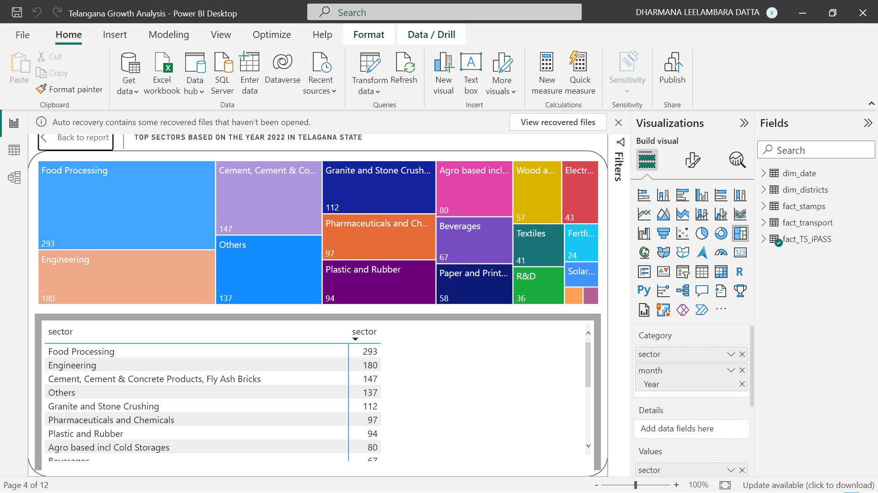
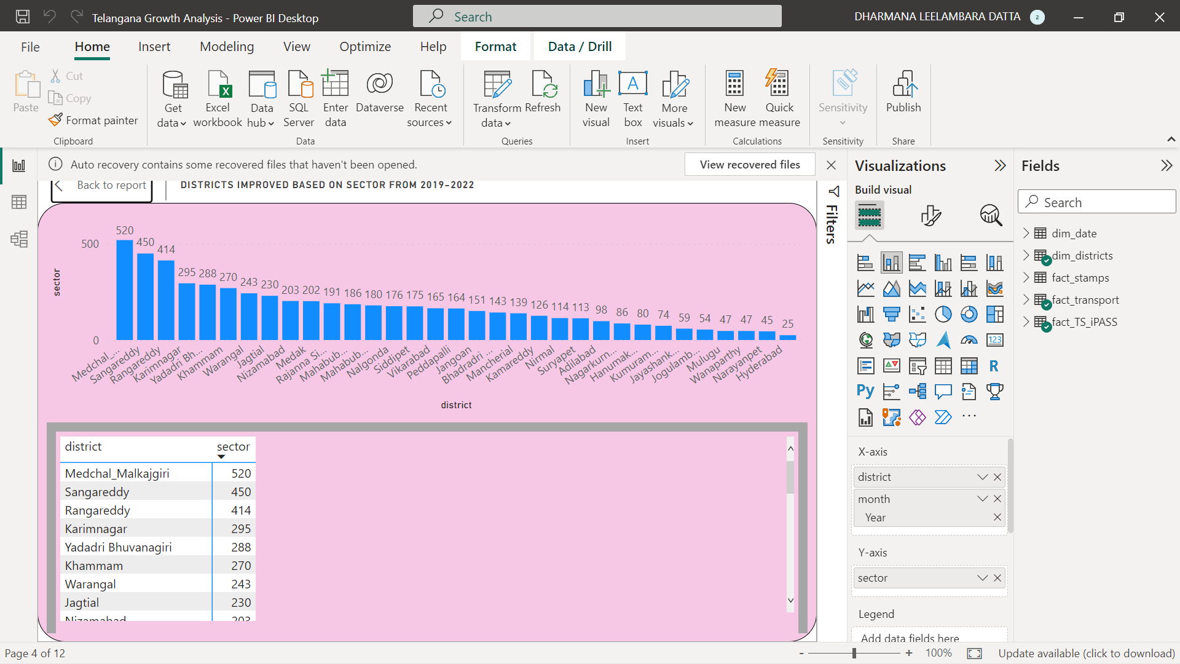
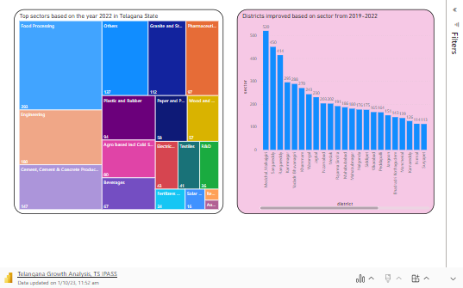
PRIMARY RESEARCH
TS I PASS (Telangana State Industrial Project Approval and Self Certification System)
List down the top 5 sectors that have witnessed the most significant investments in FY 2022
List down the top 3 districts that have attracted the most significant sector investments during FY 2019 to 2022? What factors could have led to the substantial investments in these particular districts?
.

Slide 13
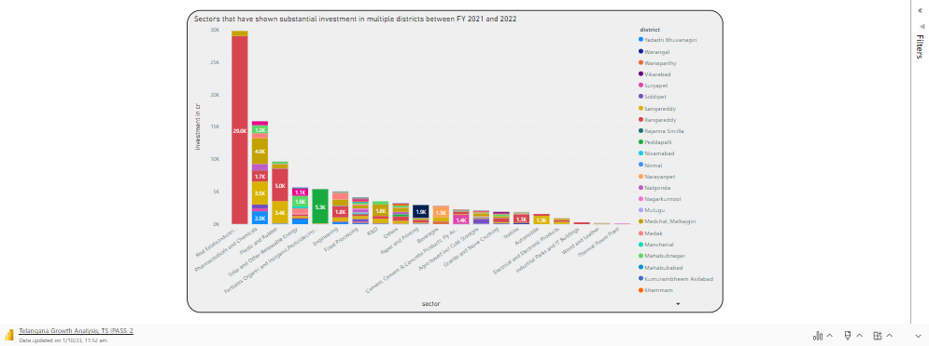
PRIMARY RESEARCH
TS I PASS (Telangana State Industrial Project Approval and Self Certification System)
Are there any particular sectors that have shown substantial investment in multiple districts between FY 2021 and 2022?

Slide 14
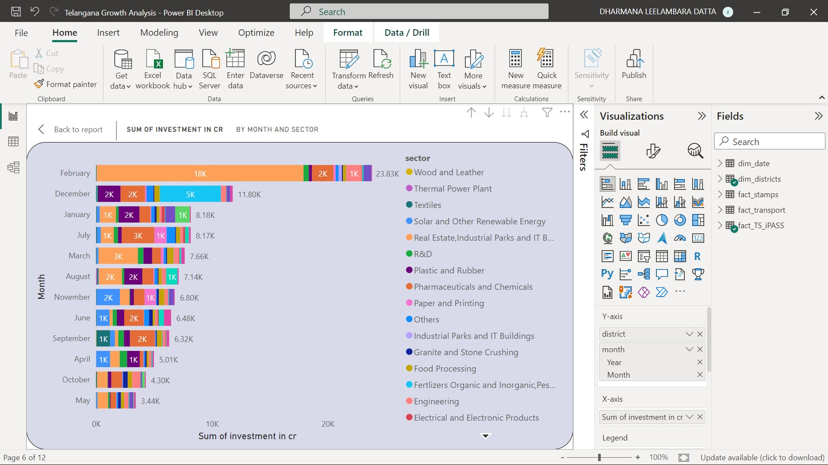
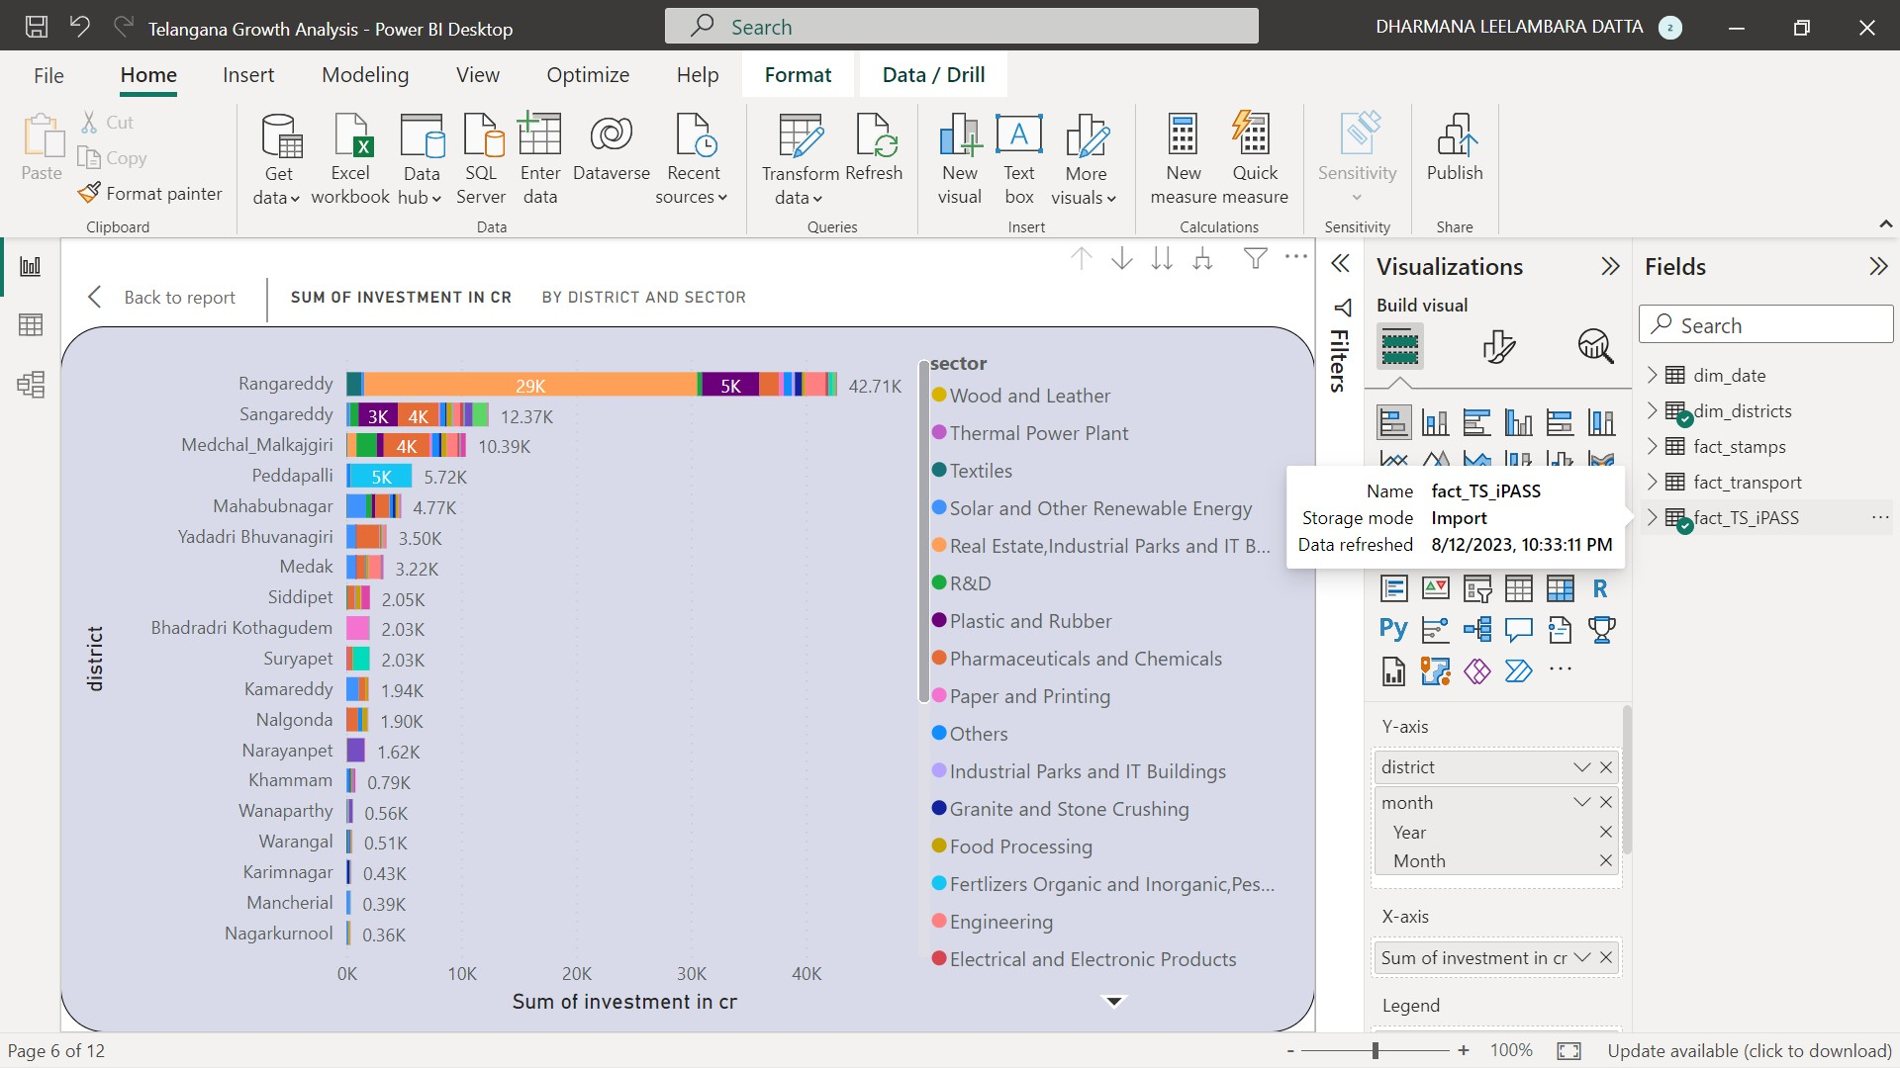
PRIMARY RESEARCH
TS I PASS (Telangana State Industrial Project Approval and Self Certification System)
Can we identify any seasonal patterns or cyclicality in the investment trends for specific sectors? Do certain sectors experience higher investments during particular months?
.
Is there any relationship between district investments, vehicles sales and stamps revenue within the same district between FY 2021 and 2022?
.

Slide 15
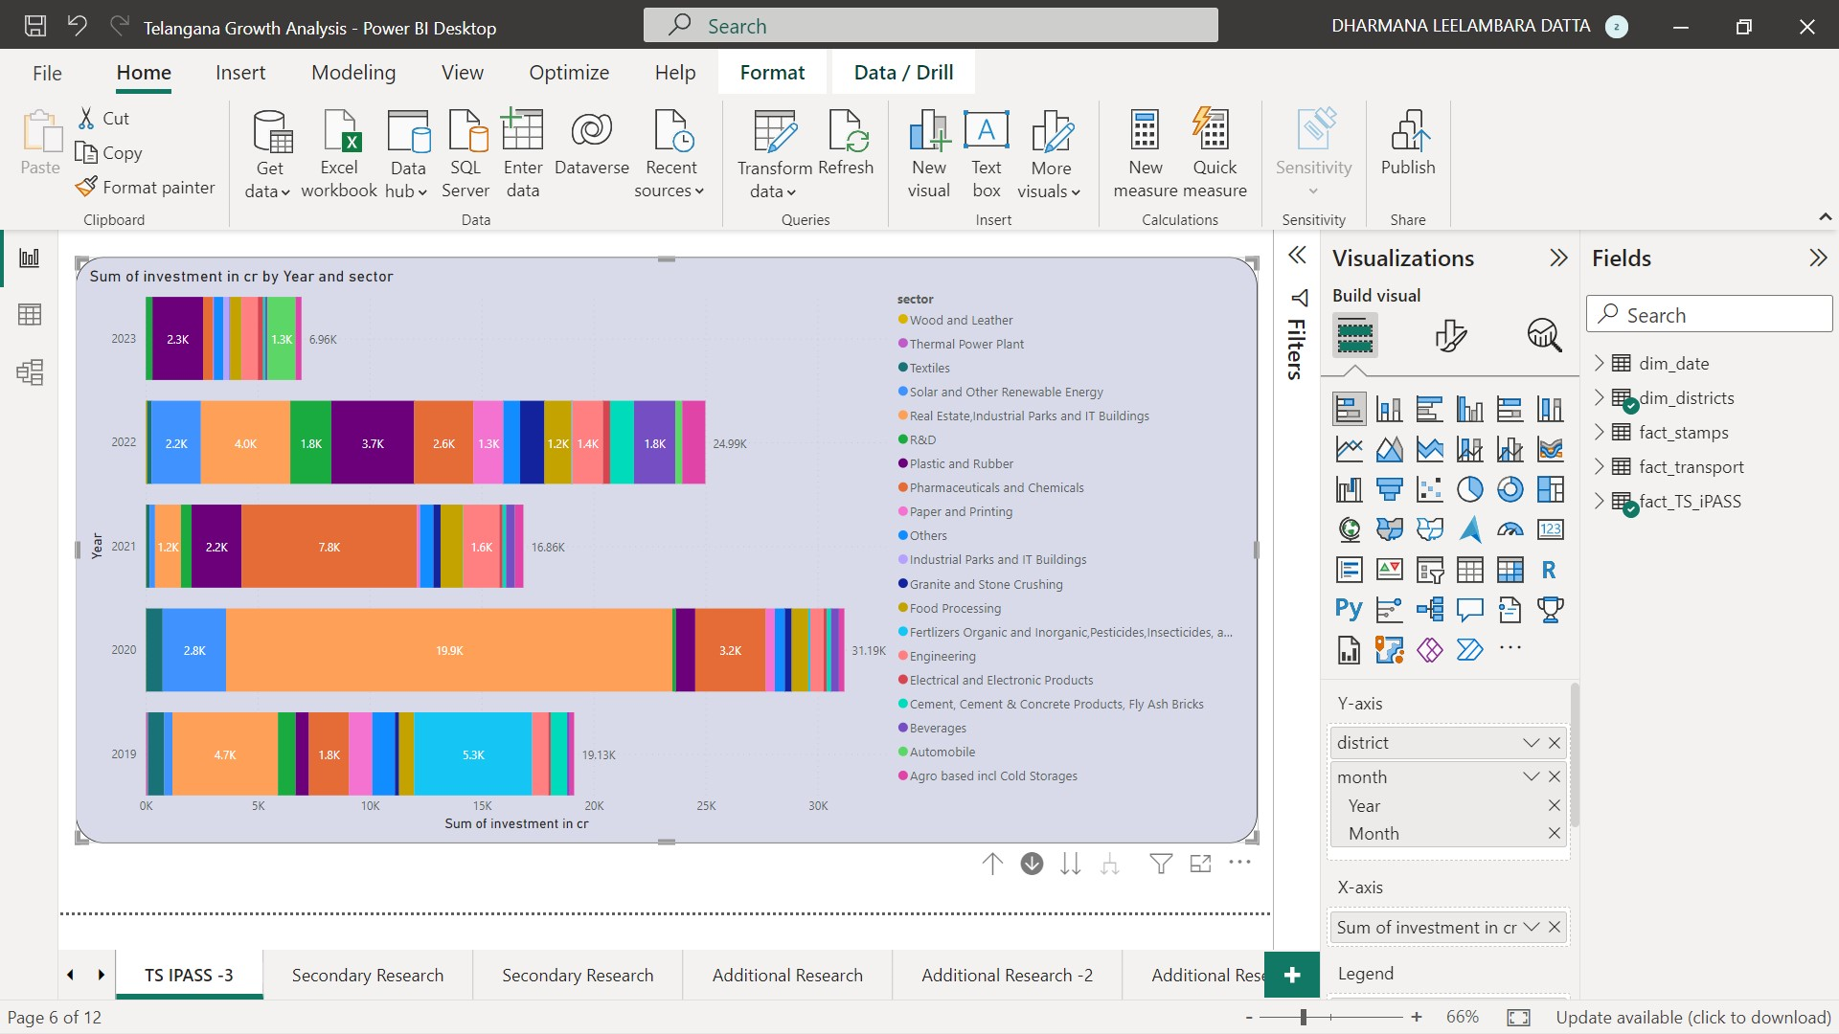
PRIMARY RESEARCH
TS I PASS (Telangana State Industrial Project Approval and Self Certification System)
Is there any relationship between district investments, vehicles sales and stamps revenue within the same district between FY 2021 and 2022?

Slide 16
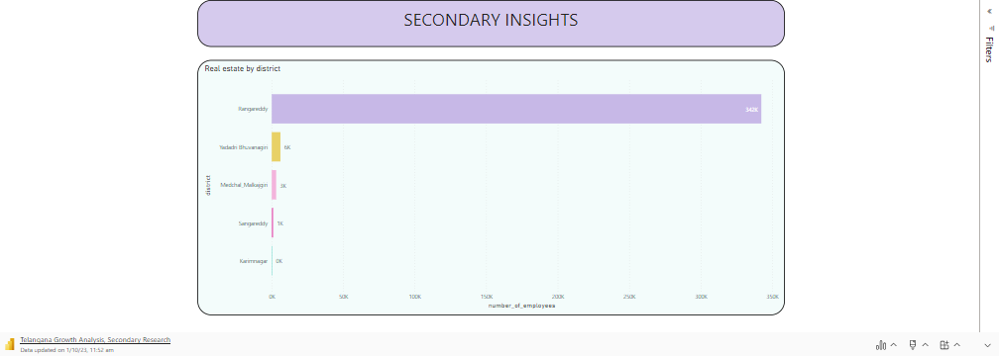
SECONDARY RESEARCH
What are the top 5 districts to buy commercial properties in Telangana? Justify your answer.

Slide 17
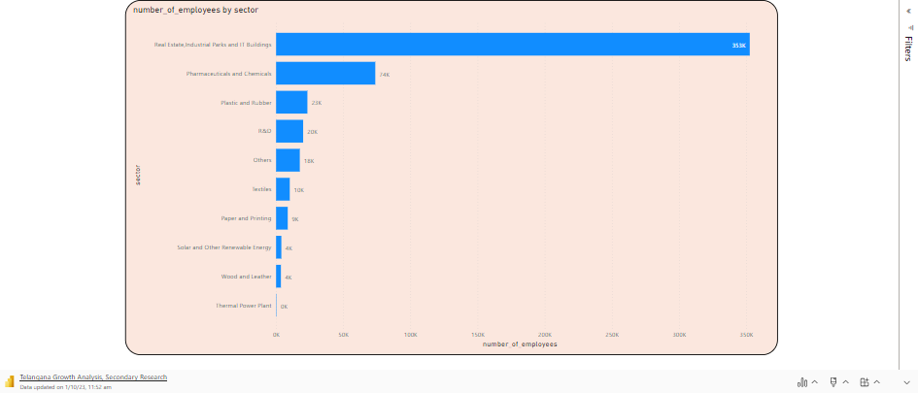
SECONDARY RESEARCH
What significant policies or initiatives were put into effect to enhance economic growth, investments, and employment in Telangana by the current government? Can we quantify the impact of these policies using available data?

Slide 18
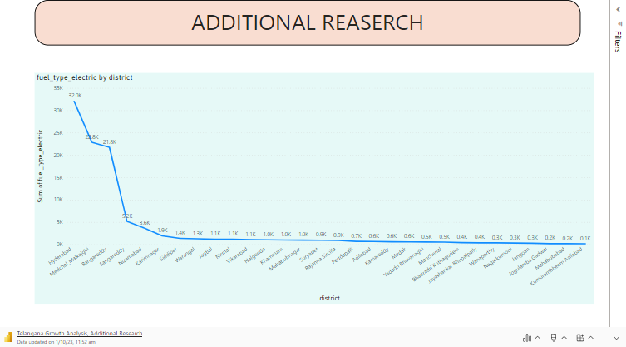
ADDITIONAL RESEARCH
ELECTRIC VEHICLE USAGE BASED ON DISTRICT

Slide 19
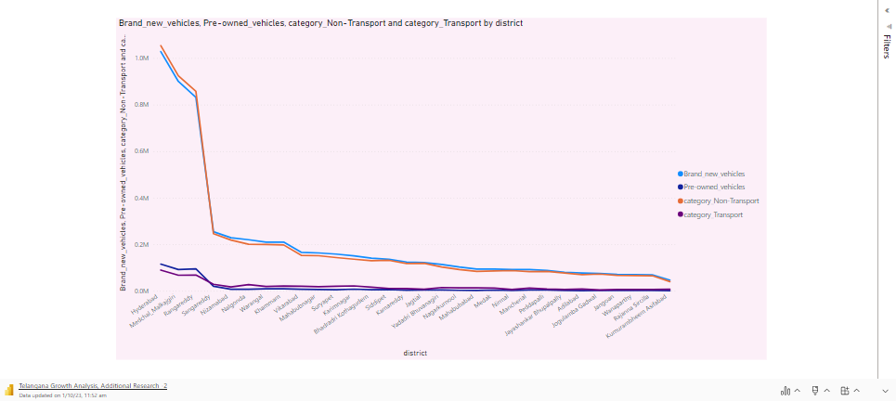
ADDITIONAL RESEARCH
SALES OF VEHICLES BY OTHER CATEGORIESBASED ON DISTRICT

Slide 20
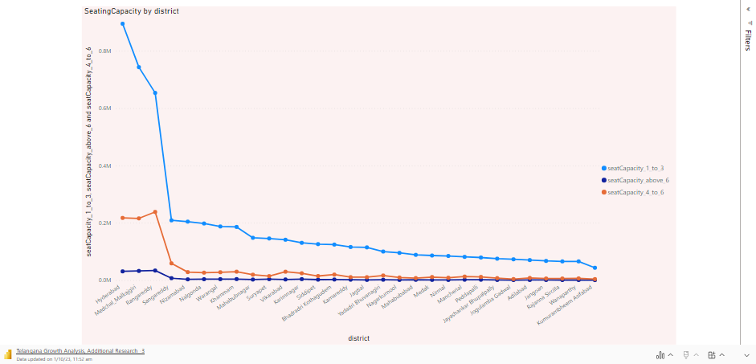
ADDITIONAL RESEARCH
VEHICLE SALES CATEGORIZED BY SEATING CAPACITYBASED ON DISTRICT

Slide 21
INSIGHTS
E-Challan Usage
The overall percentage of individuals with no e-challan count across various scenarios is approximately 6.03%.
Stamp Revenue Collection
Ranga Reddy district leads in collecting the highest revenue generated from stamp registration.
Jaya Shankar Bhupally district has not reported any registered revenue generated during the analyzed period.
Top Sector in Ranga Reddy
Ranga Reddy district tops the list in terms of investment in the real estate and IT sector, specifically in building construction.
Unique Contribution of Pedapalli
Pedapalli district is the sole contributor to the fertilizer sector among the analyzed districts.
Monthly Revenue Peaks
The month of February records the highest amount of revenue investment, with Ranga Reddy district leading the way. Notably, real estate is the dominant sector during this period.
Conversely, May sees the least investment, with Nagar Kurnool district reporting the lowest figures.
Year-wise Investment Trends
Investment trends, in descending order of crores generated, are as follows: 2023, 2021, 2019, 2022, and 2020.
Workforce Allocation
The real estate sector employs the highest number of individuals, followed by the pharmaceutical sector.
Vehicle Sales Competition
There is significant competition between the "category_Non-Transport" and "brand new vehicles sale" categories.
Electric Vehicle Usage by District
Electric vehicle usage, based on districts, in descending order: Hyderabad, Medchal_Malkajgiri, Ranga Reddy, Sangareddy, and Nizamabad.
Seating Capacity Preference
The majority of individuals prefer vehicles with a seating capacity of 1-3, followed by 4-6, and then seating capacity above 6 in the mentioned districts.
These insights offer valuable information about revenue collection, sectoral preferences, and district-wise trends, aiding informed decision-making for the government and stakeholders.

Slide 22
RECOMMENDATIONS
Enhanced Data Authentication It's crucial to prioritize the accuracy and authenticity of registration entries. By ensuring that the registration process is meticulous and verified, we can significantly boost the precision of revenue generation.
Diversified Economic Focus: While real estate is important, it's equally vital to diversify our focus across various sectors for Telangana's holistic development. By nurturing a well-rounded economy, we can achieve sustainable growth.
Promotion of Electric Vehicles: Encouraging the adoption of electric vehicles stands as a proactive step towards reducing pollution and conserving precious natural resources. This move aligns with our commitment to environmental sustainability.
Effective Awareness Campaigns: To foster development across districts and fields, we should launch targeted awareness campaigns. These campaigns can serve as catalysts for growth by educating and engaging various sectors within our diverse state.
Seasonal Revenue Consistency: Our visual data reveals fluctuations in revenue generation across months, indicating sensitivity to outliers. To address this, we should implement measures that ensure consistency and reliability in revenue streams, regardless of seasonal variations.
Unity for Growth: Telangana's strength lies in unity. We should actively encourage participation and engagement across various fields and sectors. By promoting a collaborative spirit, we can collectively work towards the growth and prosperity of our state.
These recommendations underscore our commitment to a well-organized, sustainable, and inclusive approach to Telangana's development, ensuring that all sectors thrive while safeguarding our environment and maintaining the highest standards of data integrity.

Slide 23
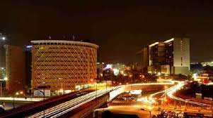
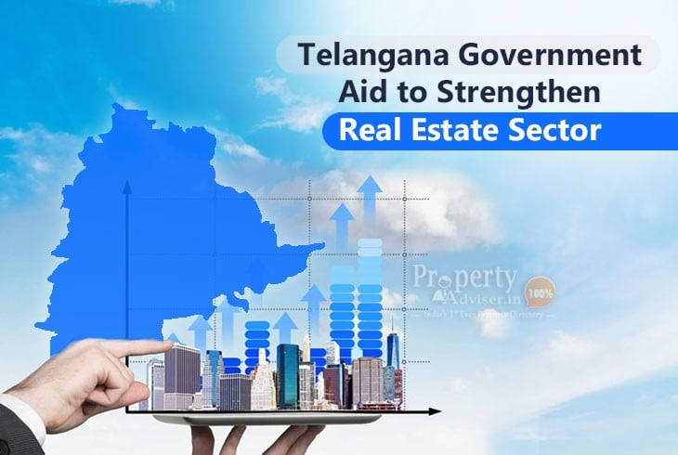
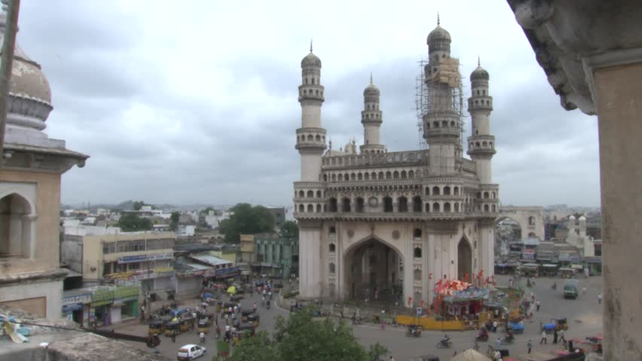
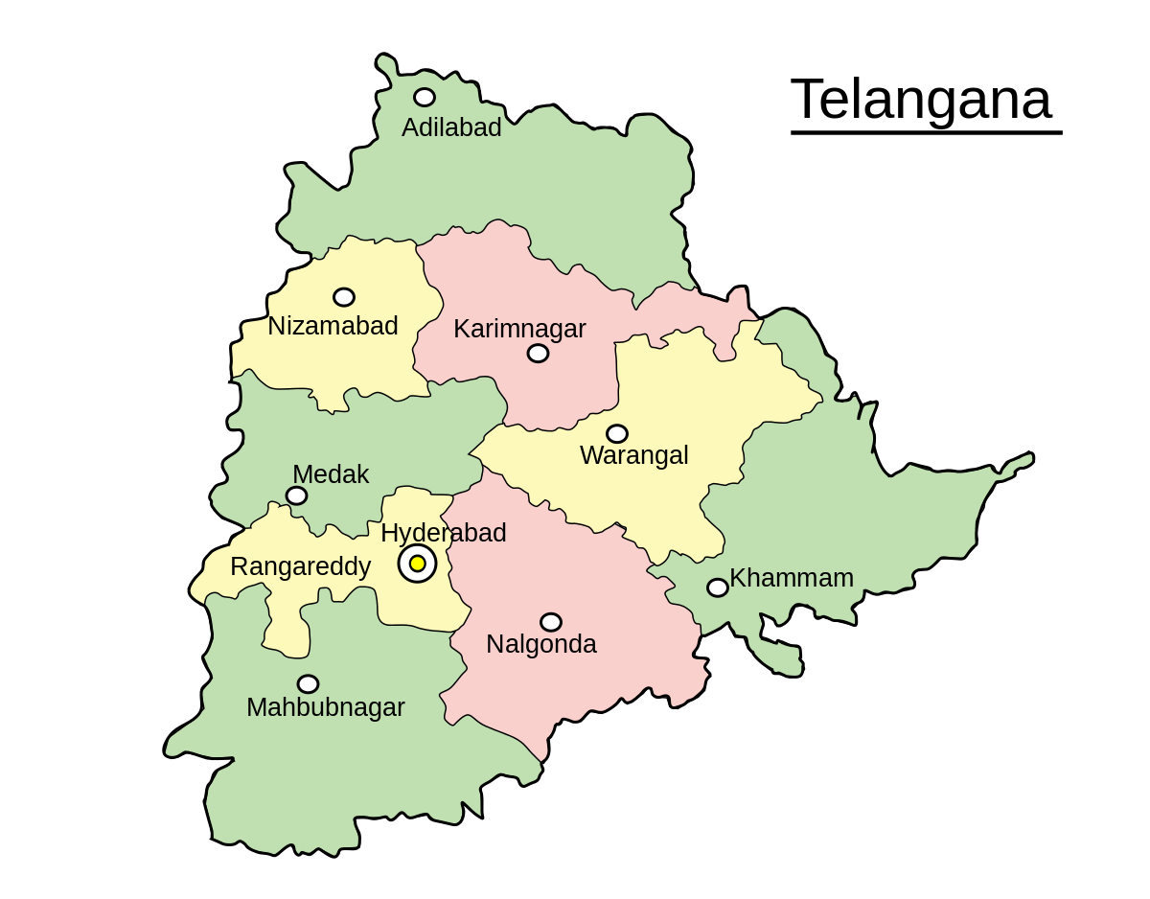

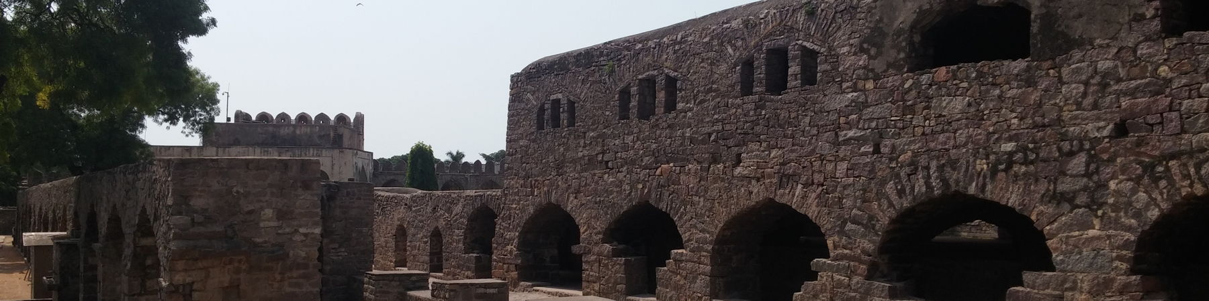
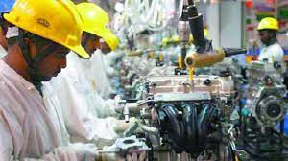
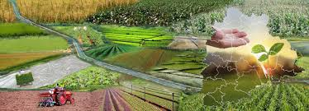

Slide 24
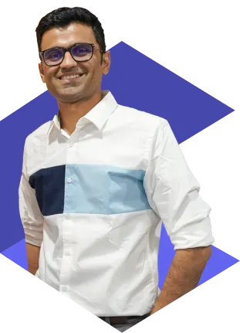

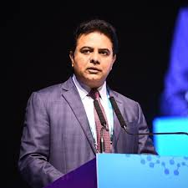
HEMANAND VADIVEL SIR
Data Analytics Manager, 8+ Years in Europe, Microsoft Certified, Certified Supply Chain Professional
DHAVAL PATEL SIR
Data Entrepreneur (12+ Years), YouTuber, Ex - Bloomberg, NVIDIA
Kalvakuntla Taraka Rama Rao (born 24 July 1976), popularly known by his initials KTR, is an Indian politician serving as the Minister for Municipal Administration and Urban Development; Industries and Commerce; and Information Technology, Electronics and Communications of Telangana.

Slide 25
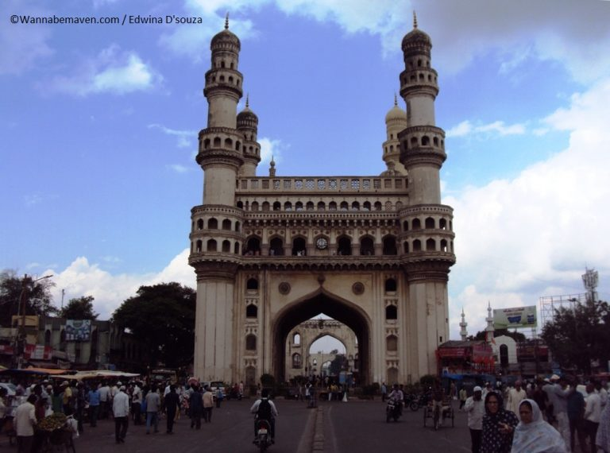

This Photo by Unknown Author is licensed under CC BY-NC

